Slide 1
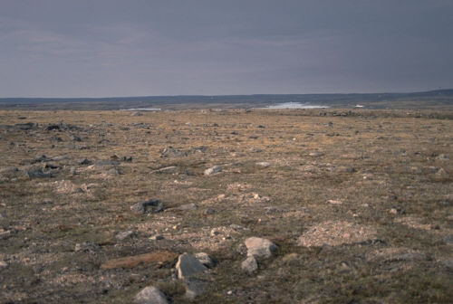
Notes:
The flat, featureless peneplain existed for 100’s of millions of years until about 600 million years ago when …

Slide 2
Notes:
…during the latest Proterozoic and earliest Cambrian, North America and "Africa" started rifting apart to form the Iapetus ocean. The rifting event extended for thousands of miles up and down eastern North America. In Virginia the axis of rifting runs right down the Blue Ridge.

Slide 3
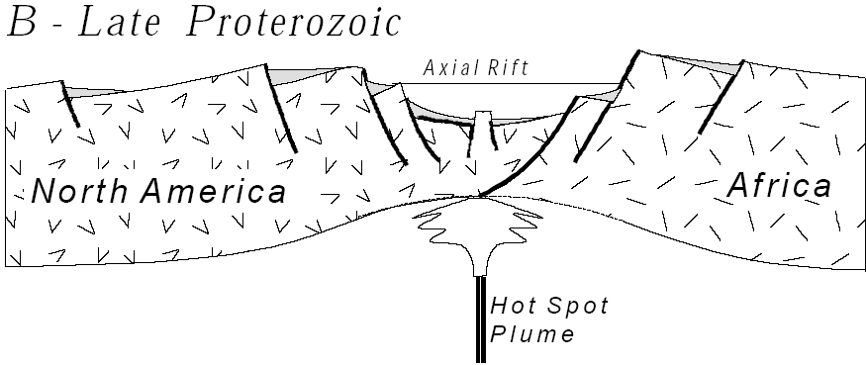
Early Paleozoic Rifting Earliest Cambrian; about 570 mya
Notes:
Rifting takes place when continental crust, heated from below by a hot spot (a plume of magma rising from the earth's interior), swells upward, thins, and stretches out like pulled taffy (notice the thinning in the cross section above). At depth the rocks are hot and plastic, but at the surface they are cold and brittle, so when they stretch with the uplift, cracks form and develop as normal faults. Along the faults some blocks of the earth slide downward and form valleys called grabens; the adjacent blocks that move up to form mountains are called horsts. The relief, or difference in elevation, from the top of the horsts to the bottom of the graben can be many kilometers. So in a sense rifting begins with mountain building also, only where mountains like the Grenville are produced by compression from a collision between continents, these horst mountains result from uplift, stretching, and tension caused by heat from below. In the center of the system there is the axial rift a narrow, steep sided valley maybe only 50-100 kilometers wide but falling a kilometer or more below sea level. Early in its history it may be dry, but in time the sea spills in filling it. On either side of the axial rift, horsts rise abruptly two or more kilometerS above sea level

Slide 4
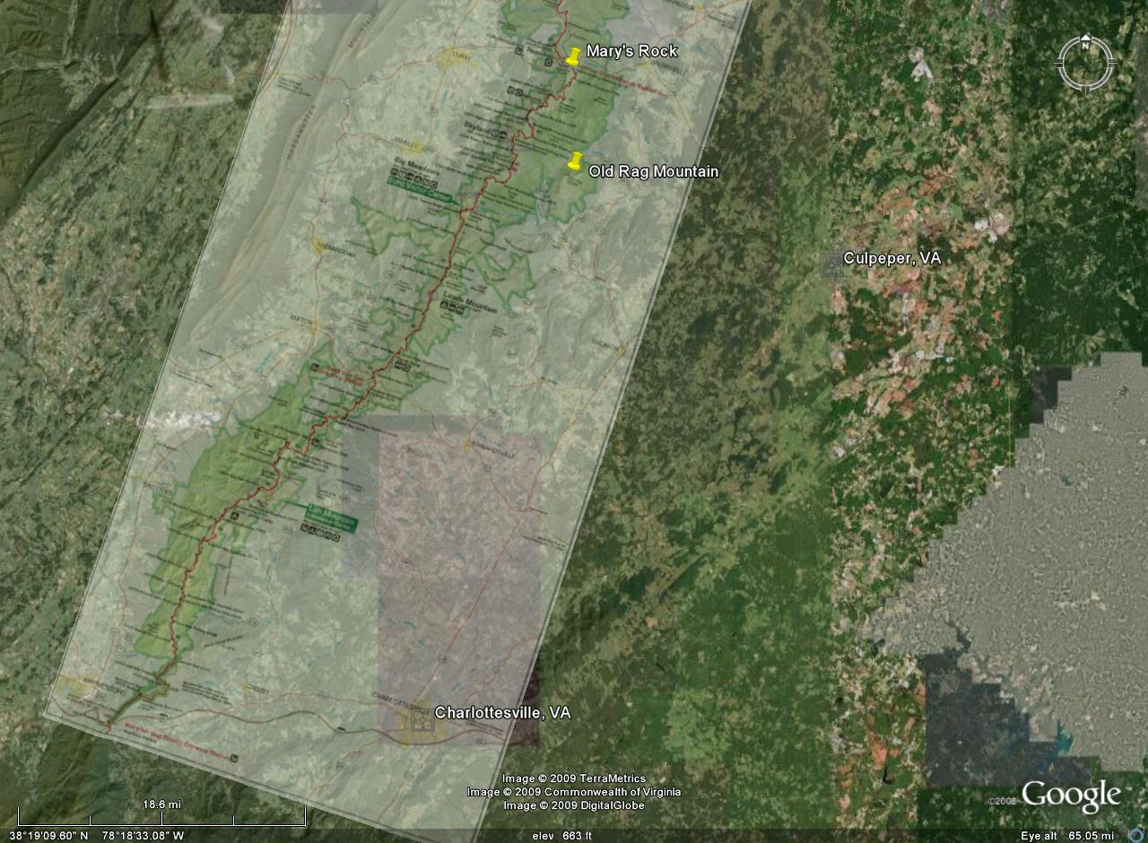
Notes:
Today the remnants of this axial rift runs through the Charlottesville and Culpepper Virginia region east of Shenandoah.

Slide 5
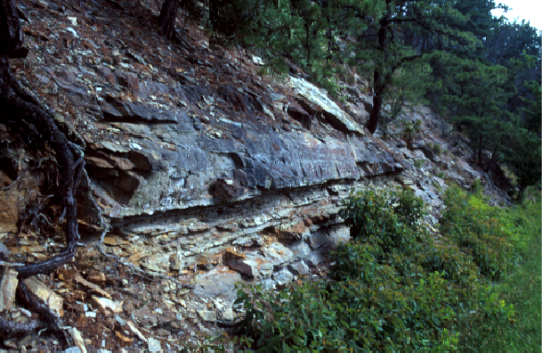
Ancient Rift Valley Strata
Shenandoah National Park, Virginia
Robert J. Lillie
Parks and Plates
©2005 Robert J. Lillie
Notes:
The sedimentary rocks there and elsewhere tell us that during rifting the long, deep rift valley received coarse gravels and sandstones from the surrounding horst mountains on both sides. The western side of the rift graben is North America, but the eastern side, was "Africa".

Slide 6
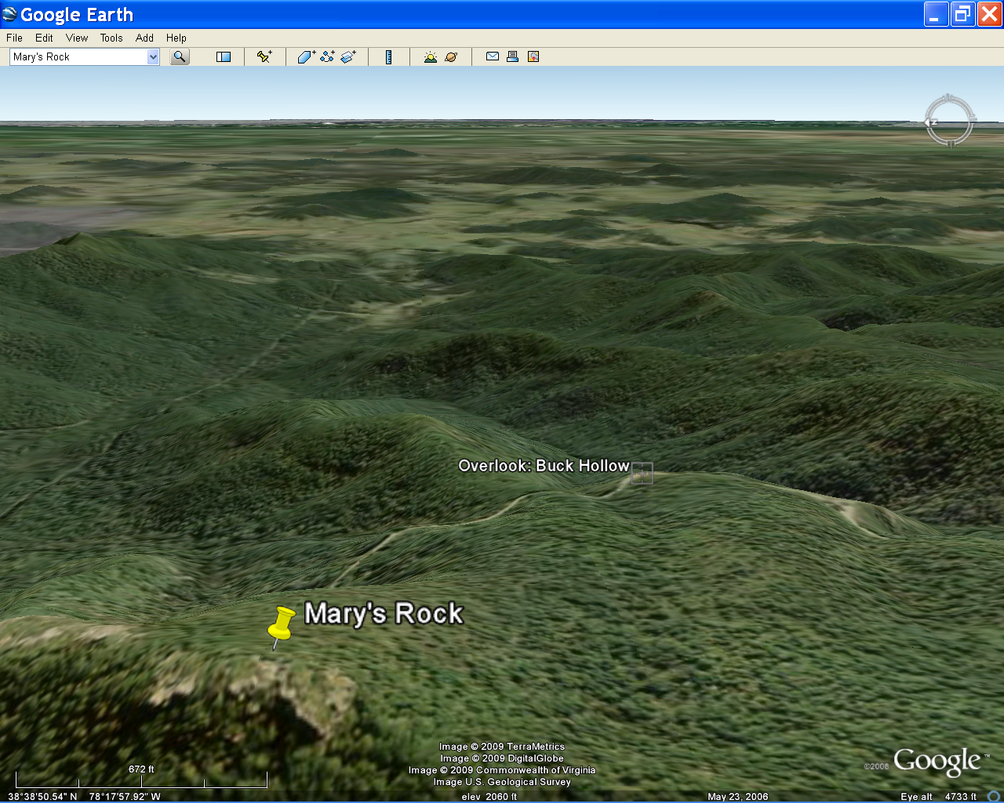
Buck Hollow Overlook
Notes:
You can almost imagine this while standing at one of the east facing overlooks along Skyline Drive today, such as Buck Hollow overlook . The current topography, however, results from the much more recent rifting of Pangaea than the Late Proterozoic rifting of Pannotia.

Slide 7
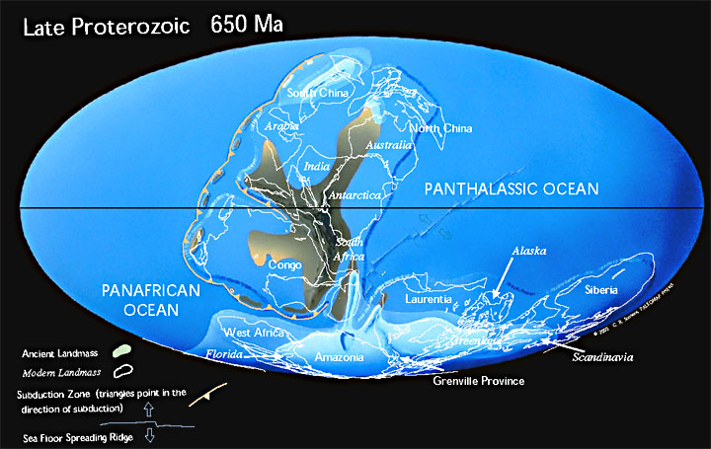
Rodinia becomes Pannotia
Notes:
If you have read some of the recommended material you will probably see Rodinia rather than Pannotia referenced as the supercontinent that rifted in the Late Proterozoic. This is probably because Pannotia was rather short lived and consisted of subcontinents that were already somewhat rifted when it formed.

Slide 8
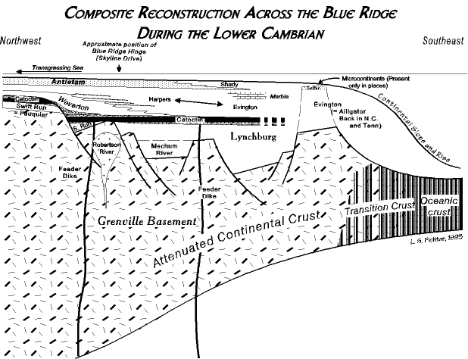
Notes:
Evidence of the Late Proterozoic rifting event is preserved in sedimentary and volcanic units that filled the ancient grabens. Since these basins would have received sediments from relatively nearby horsts, deposition would be rapid and sediments immature.

Slide 9
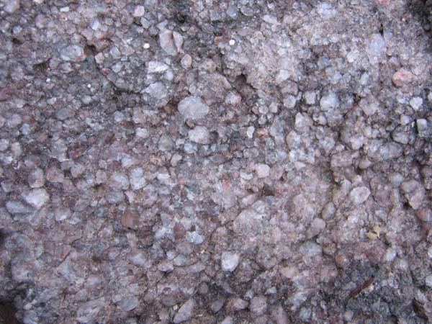
Typical immature rift valley sediment
Swift Run Formation
Notes:
These sediments, of the Swift Run Formation, are interpreted as steam valleys filled with sediment, draining the Grenville range. They are compositionally immature, with large, angular grains of feldspar. Width of photograph is approximately six inches.

Slide 10
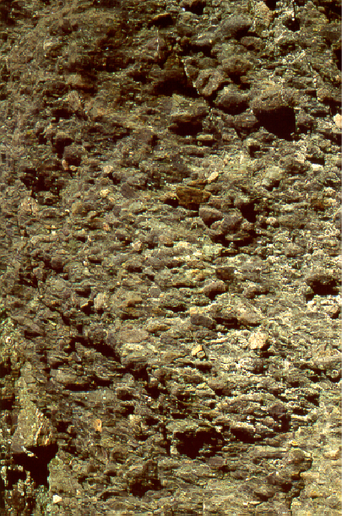
Ancient Rift Valley Strata
Coarse Conglomerate Deposited by Fast-Moving Streams
Blue Ridge Parkway, North Carolina
Robert J. Lillie
Parks and Plates
©2005 Robert J. Lillie
Notes:
This coarse, poorly sorted, feldspar-rich conglomerate from the Blue Ridge Parkway that connects Shenandoah with Great Smokey is typical of the types of sediment that filled the Late Proterozoic rift valleys.

Slide 11
Great Smokey
Shenandoah
Acadia
Closing
Collision Orogeny
Peneplanation
Rifting
Opening
Notes:
Ample evidence for rifting exists in both Shenandoah and Great Smokey National Parks.

Slide 12
Ocoee Supergroup
Notes:
One of the largest rift valleys is represented by the Ocoee Supergroup …

Slide 13
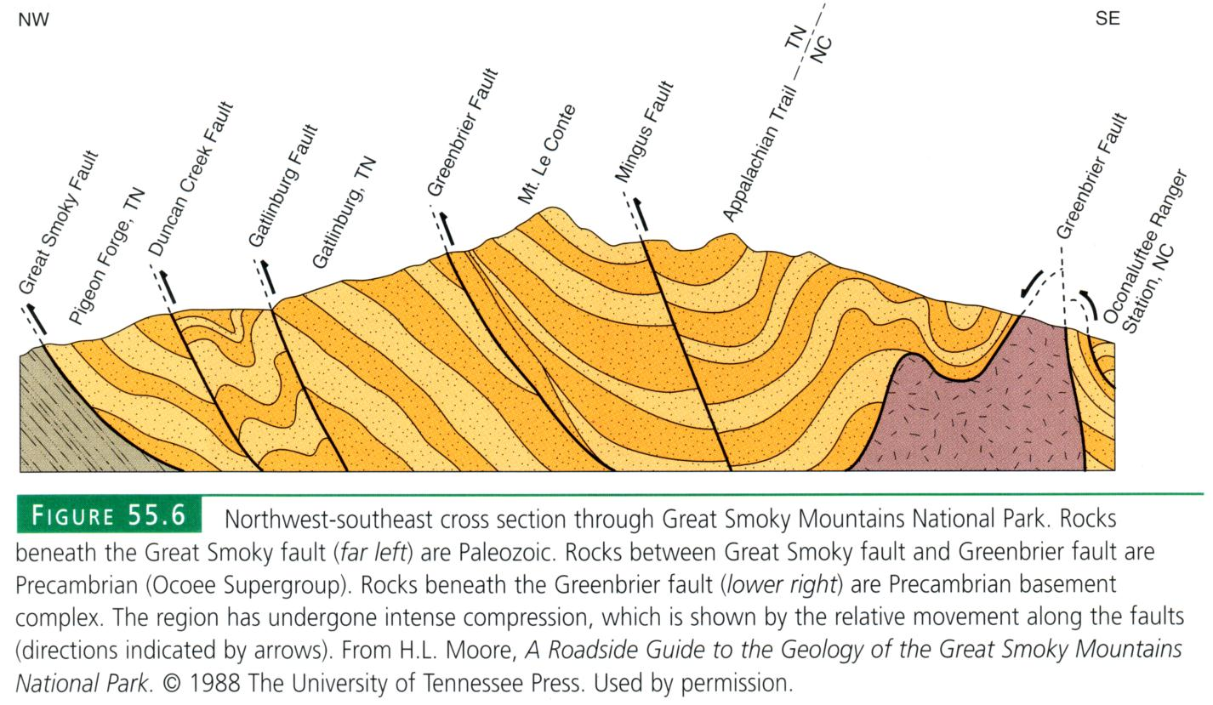
Notes:
… which makes up the bulk of the folded sediments in the great syncline of Great Smokey's National Park.

Slide 14
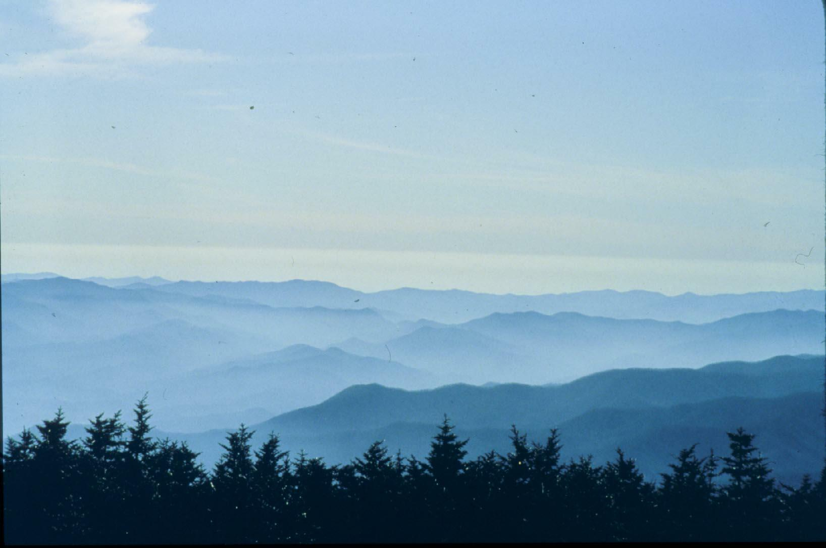
“Smoke” = Gulf of Mexico humidity + plant terpines
Notes:
The infamous “smoke” here forms from the combination of humidity from the Gulf of Mexico and volatile plant-produced compounds called terpines.

Slide 15
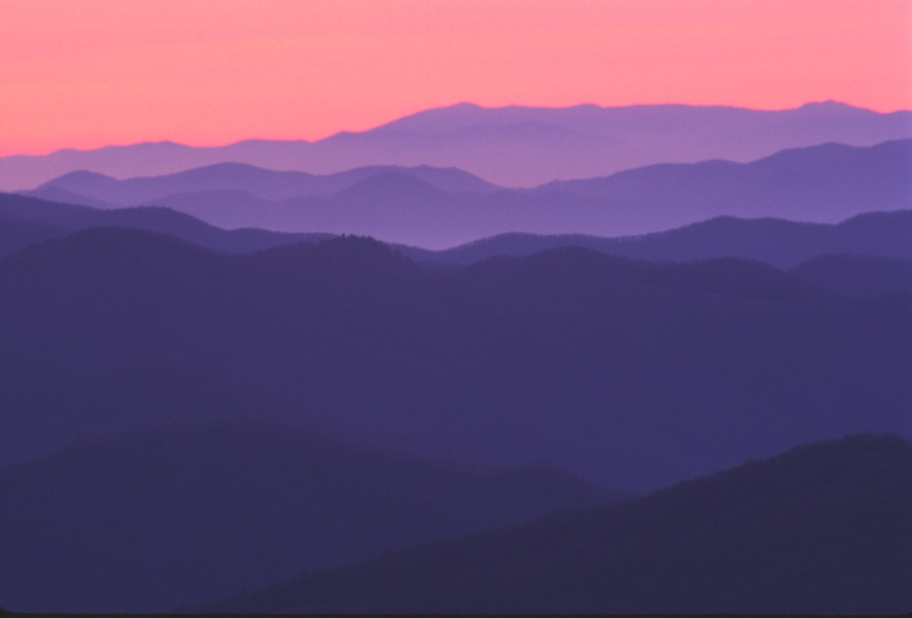
Notes:
By providing contrast between the distant mountains and those in the foreground the smoke accentuates the multi-ranged character of that results from folding in the Ocoee Group.

Slide 16
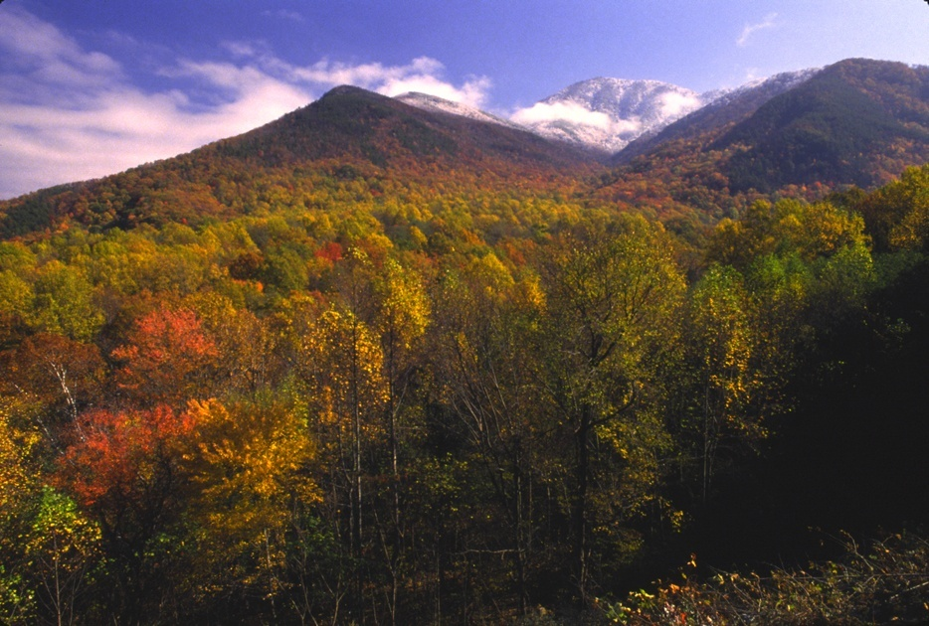
Notes:
Vistas are far clearer in less humid months and when photosynthesis and the production of plant terpines slows. This picture illustrates the much greater relief of the Blue Ridge in the Smokey’s relative to that of Shenandoah.

Slide 17
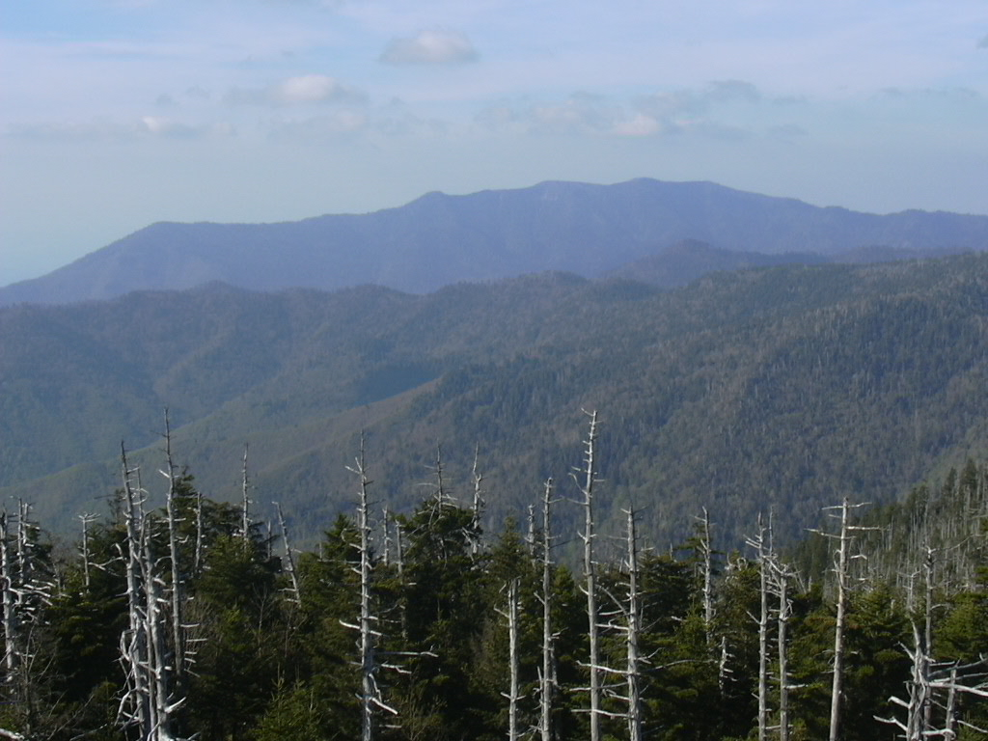
Notes:
Several peaks in the Smokey’s exceed 6,000’ like Mount LaConte here …

Slide 18
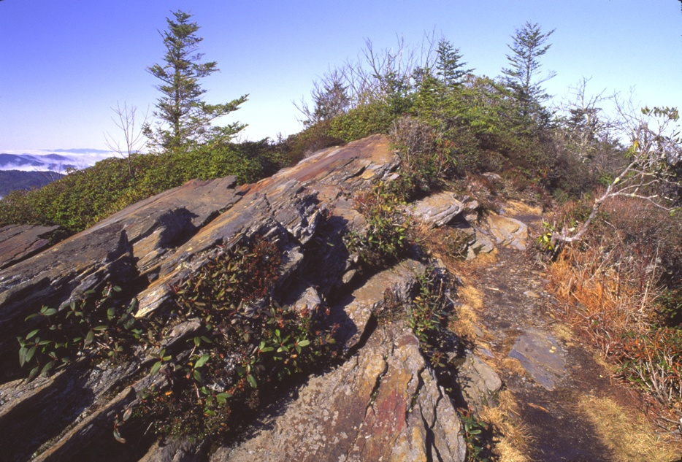
Ocoee Group sediments atop Mt. LeConte
Notes:
… where the old Ocoee Group sediments outcrop like they do on most of the peaks in Great Smoky Mountains National Park.

Slide 19
Notes:
Structurally, Mount LeConte is an upturned limb of the synclinally folded Ocoee sediments.

Slide 20
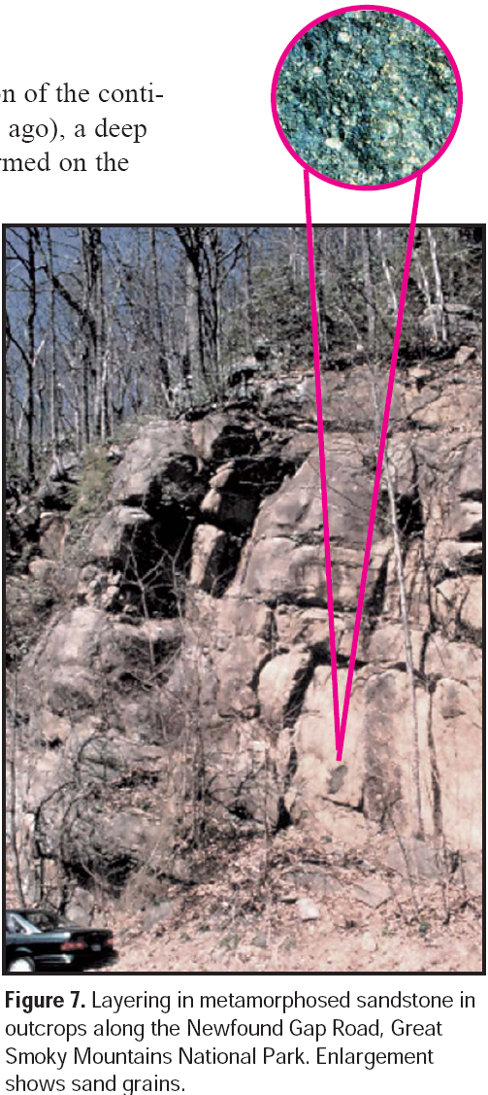
Notes:
Like their counterparts in Shenandoah, the Ocoee sediments deposited rapidly into the rift basins and are correspondingly immature.

Slide 21
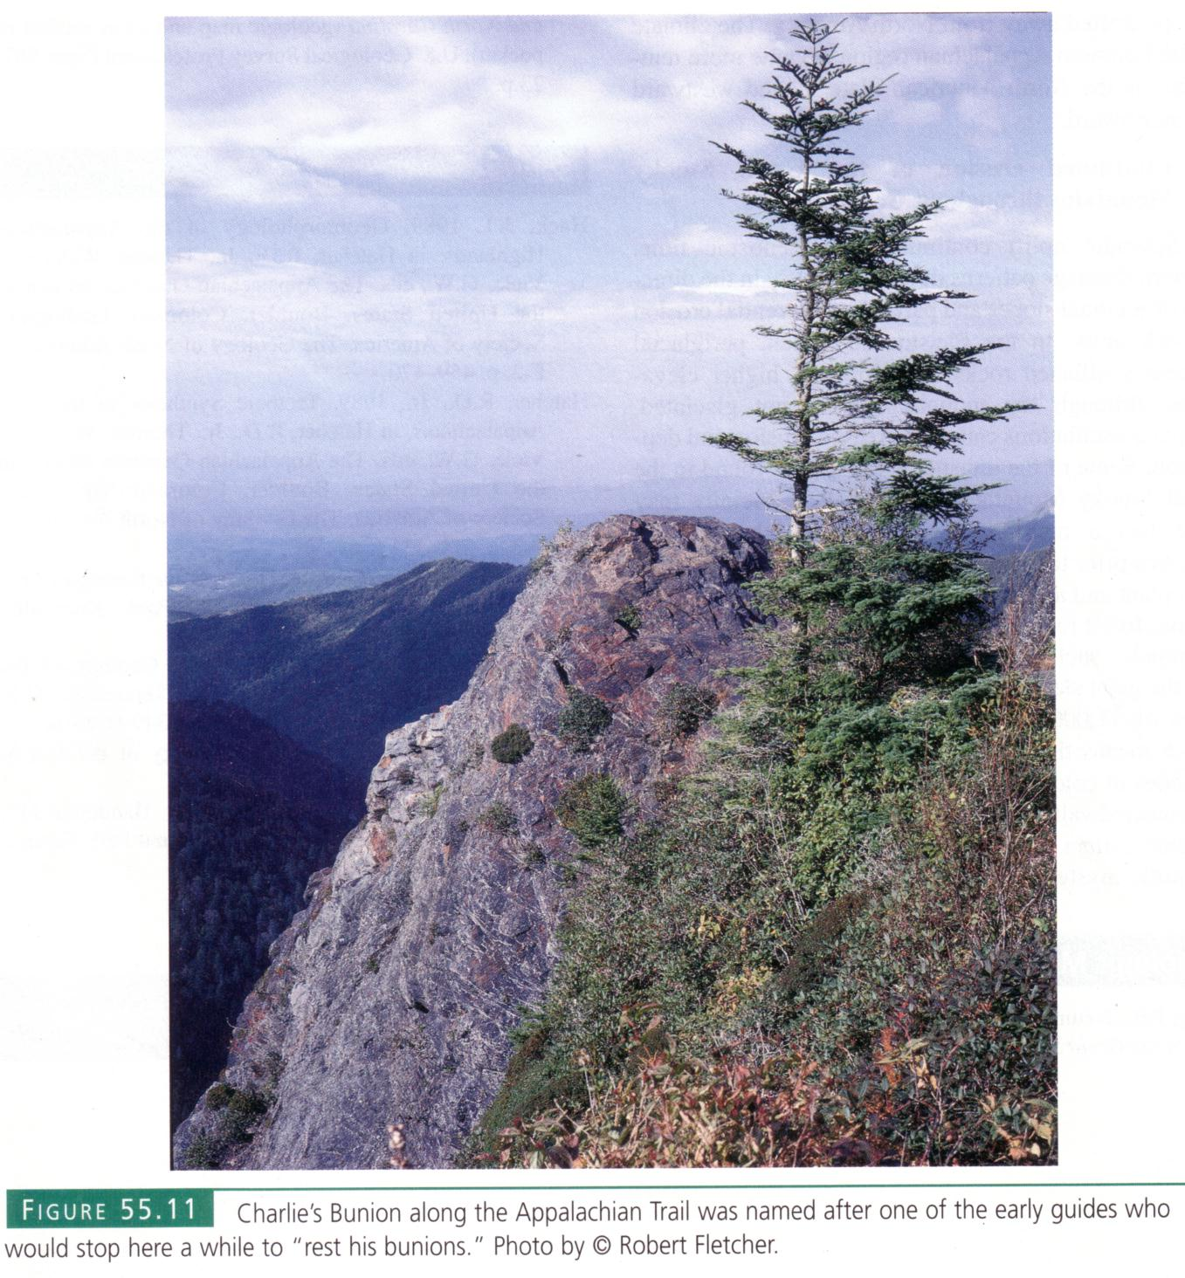
Notes:
Perhaps the most famous outcrop of Ocoee sediments is Charlie’s Bunion along the Appalachian Trail.

Slide 22
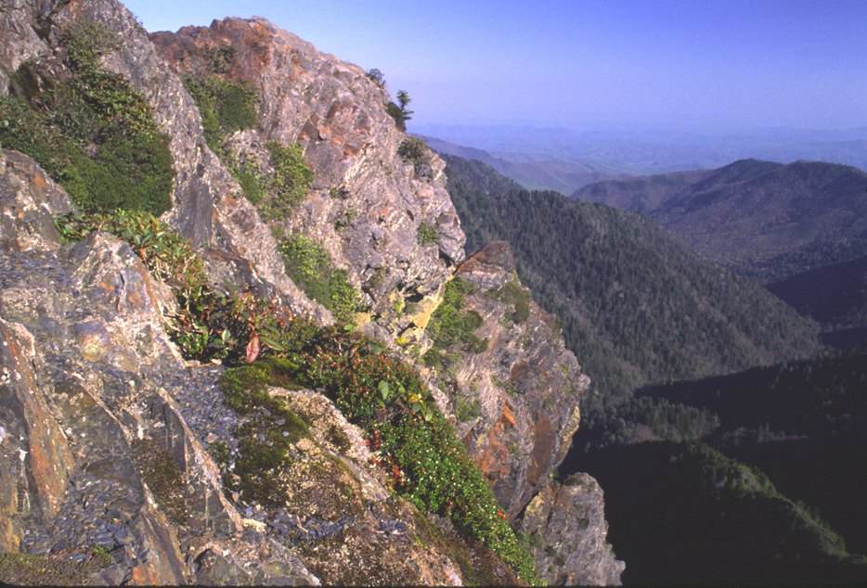
Charlie’s Bunion
Notes:
The steep slopes of Charlie’s Bunion attest to the resistance that certain Ocoee layers have to weathering and erosion. Not all Ocoee sediments are so durable, however.

Slide 23
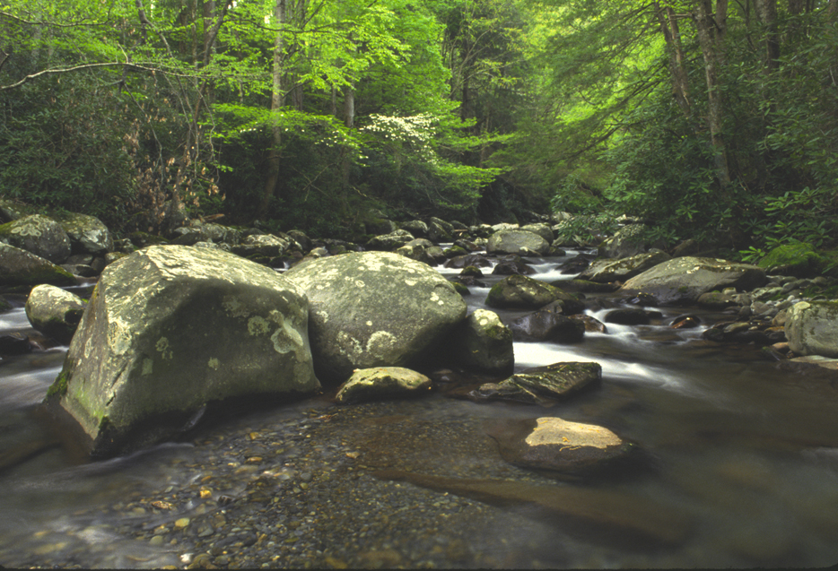
Ocoee boulder
Porter Creek
Notes:
That the erosion resistance of Ocoee strata varies is apparent along Great Smokey’s numerous streams …

Slide 24
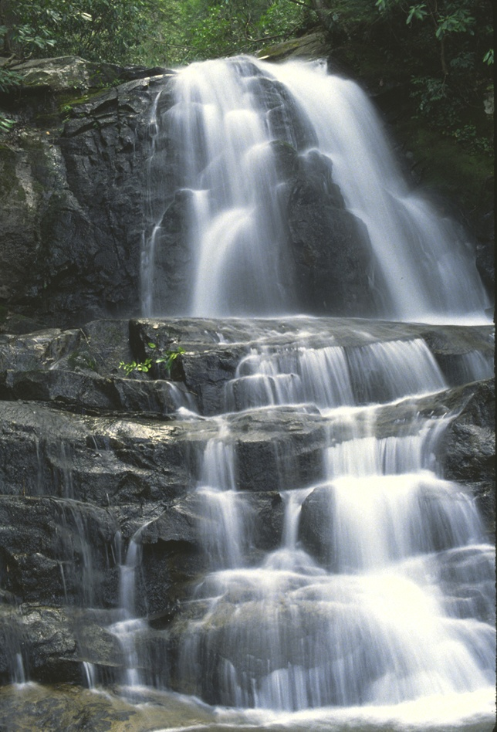
Laurel Falls
Notes:
… as waterfalls typically occur where resistant rocks overlie more erodible rocks.

Slide 25
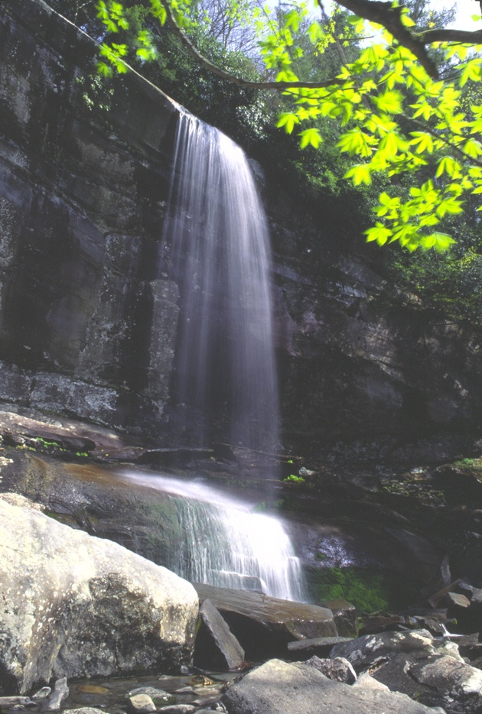
Thunderhead Sandstone
Rainbow Falls
Notes:
This is particularly true at Rainbow Falls where water cascades over one of the park’s most prolific cliff formers, the Late Proterozoic Thunderhead Sandstone. Rift valleys are not only filled with immature sediments ….

Slide 26
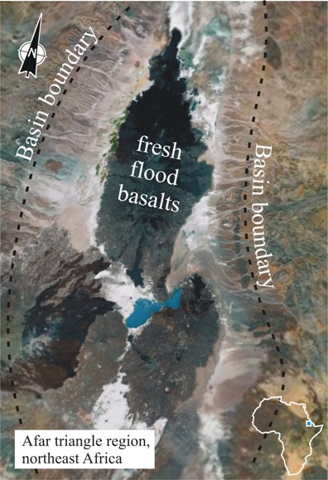
Notes:
… but basaltic flows are also characteristic of this tectonic province. Applying the principle of uniformitarianism, the modern Afar Triangle region of Ethiopia provides an analogue for what Rodinia/Pannotia may have looked like during the rifting event which created the Iapetus Ocean basin. Rifting stretches and thins the crust which thereby reduces the pressure on the underlying mantle. From its source in the mantle, lava travels upwards through the crust along a series of fractures. Fresh basaltic lava floods out over the surface. The same thing happened in Shenandoah in the late Proterozoic and formed the Catoctin Formation.

Slide 27
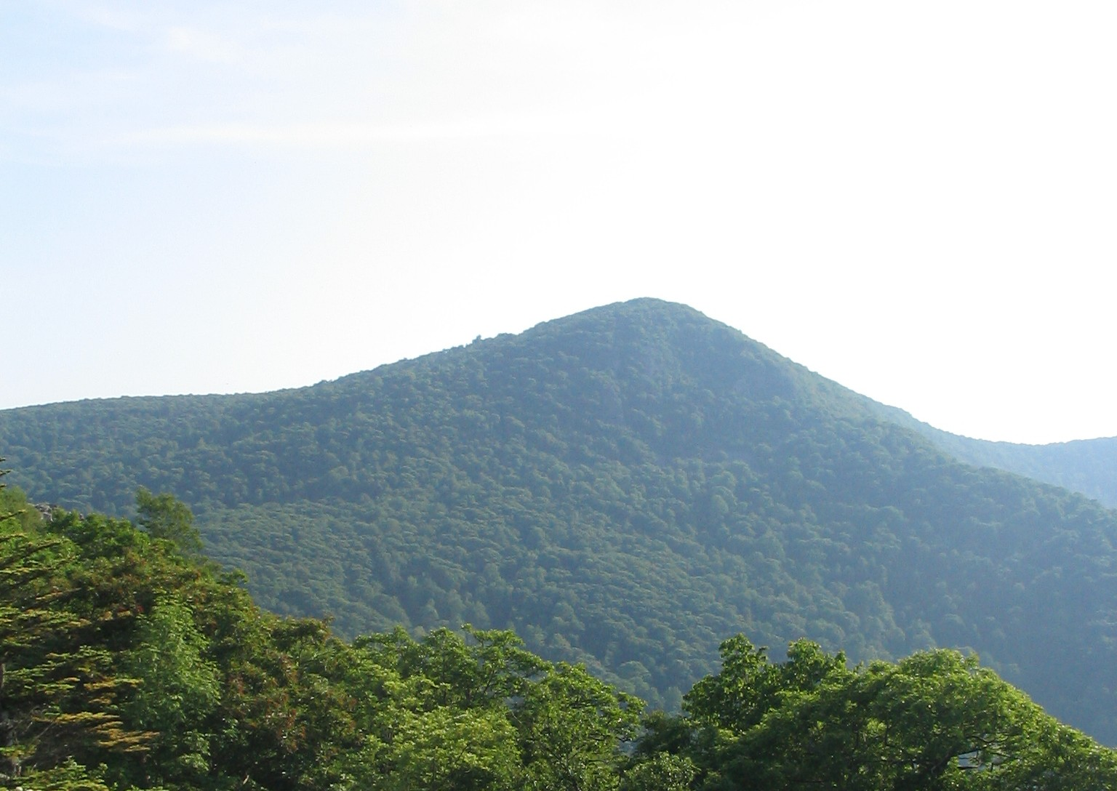
Hawksbill Mountain Shenandoah N.P.
Notes:
Like the Ocoee Group in Great Smokey N.P., the Catoctin Formation is relatively resistant and thus is found outcropping on top of the many of the park’s peaks like Hawksbill Mountain, the highest peak in Shenandoah.

Slide 28
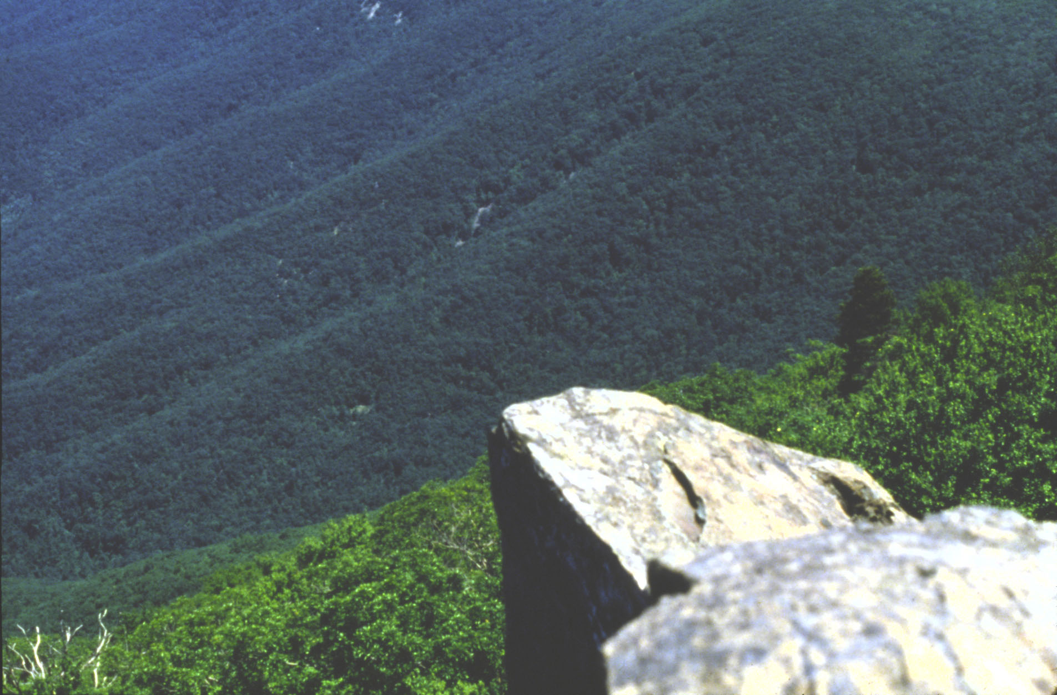
Catoctin Formation (greenstone) atop Hawksbill Mt.
Notes:
Although basalt weathers rapidly in humid environments, in most of Shenandoah it has been metamorphosed into greenstone, which is considerably more stable than basalt.

Slide 29
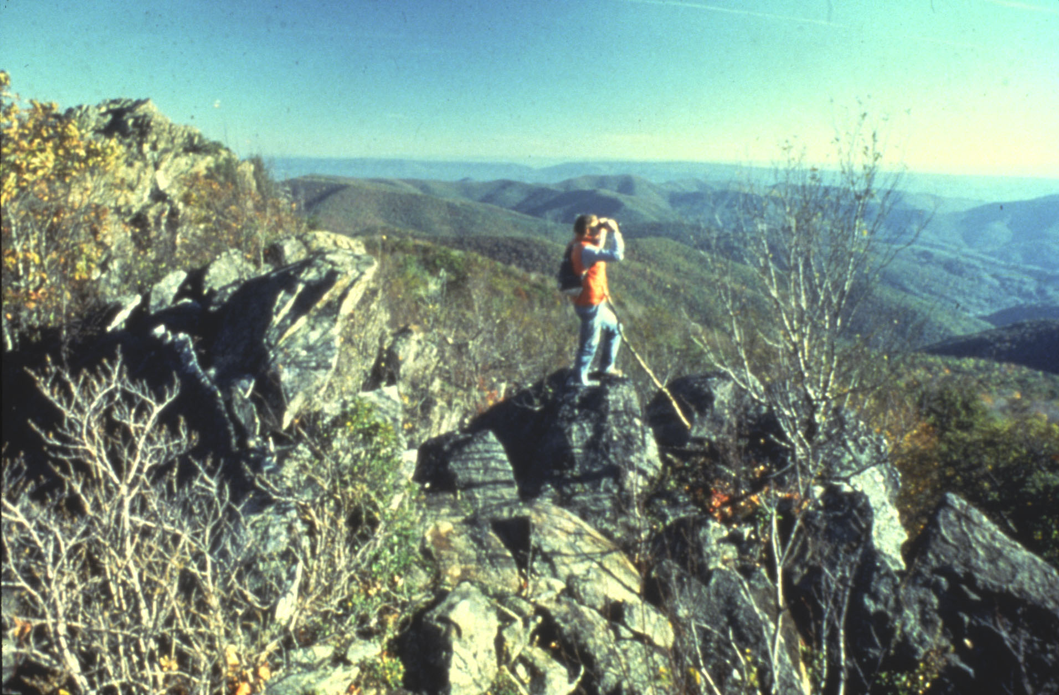
Bearfence Mt. - Catoctin basalt over Swift Run sandstone
Notes:
In most places the Catoctin lava flows rest on sedimentary rocks like the Swift Run sandstone here at Bearfence Mt.

Slide 30
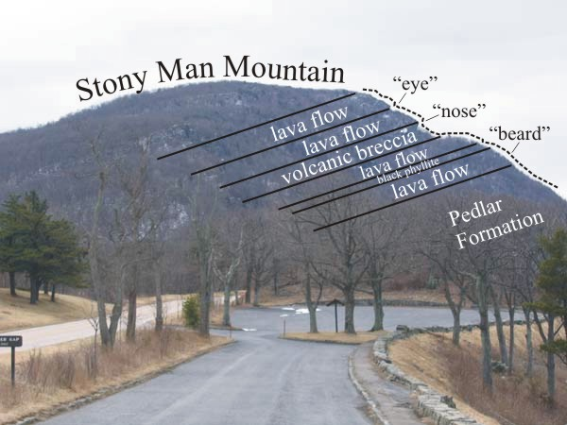
Notes:
In others, like Stony Man Mountain, the Catoctin flows poured out directly on top of the bare peneplain worn into the Pedlar Formation. Stony Man’s facial profile is due to differential weathering and erosion of flows, volcanic breccia, and phyllite from the metamorphosis of ancient soil and ash layers.

Slide 31
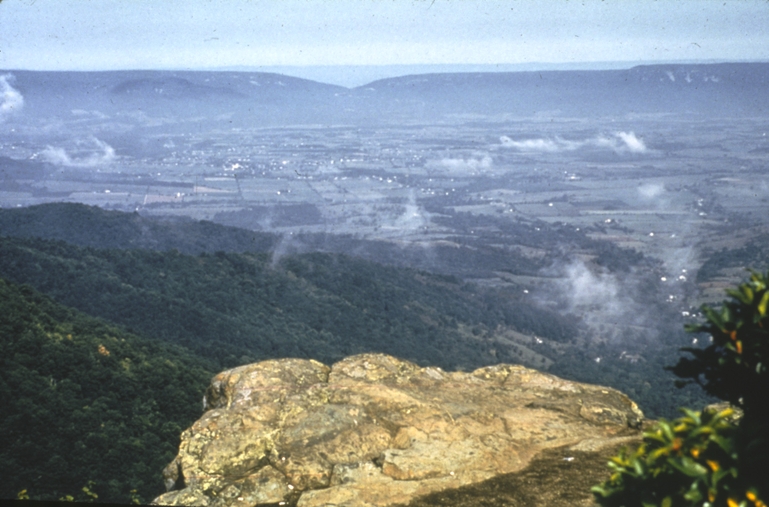
Crescent Rock – Columnar jointing in Catoctin Fm.
Notes:
In several places, like here at Crescent Rock Overlook, the Catoctin flows exhibit columnar jointing.

Slide 32
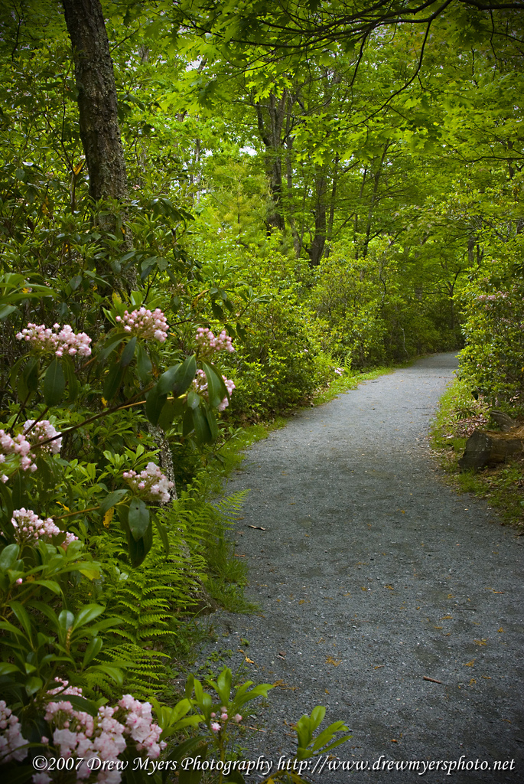
Limberlost Trail
Notes:
There are particularly good exposures of columnar basalt along Shenandoah’s sadly beautiful Limberlost Trail where tens of thousands of trees have died due to the accidental introduction of non-native insect species.

Slide 33
“Soccer-ball pattern from columnar jointing in Catoctin Formation along Limberlost Trail
Notes:
Recall that columnar jointing forms when basalt contracts equally in every direction, resulting in evenly-spaced, cracks opening up at the surface, and then extending down into the flow. The same pattern is seen as drying mud contracts and cracks into similar polygonal shapes.

Slide 34
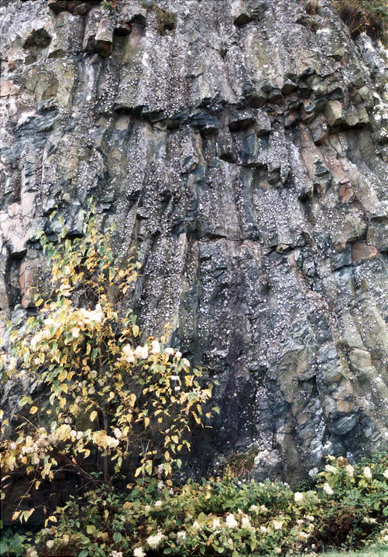
Notes:
A particularly good example of columnar basalt occurs near Indian Run Overlook in Shenandoah.

Slide 35
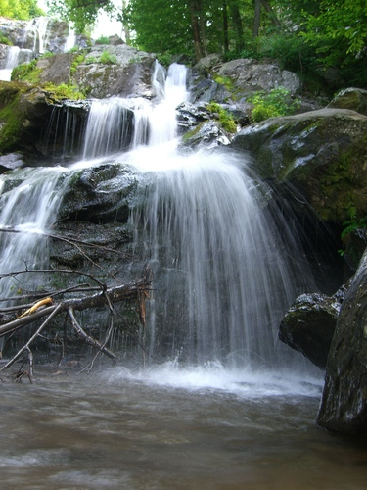
Dark Hollow Falls
Notes:
Here at Dark Hollow Falls in Shenandoah, water cascades over the Catoctin Formation.

Slide 36
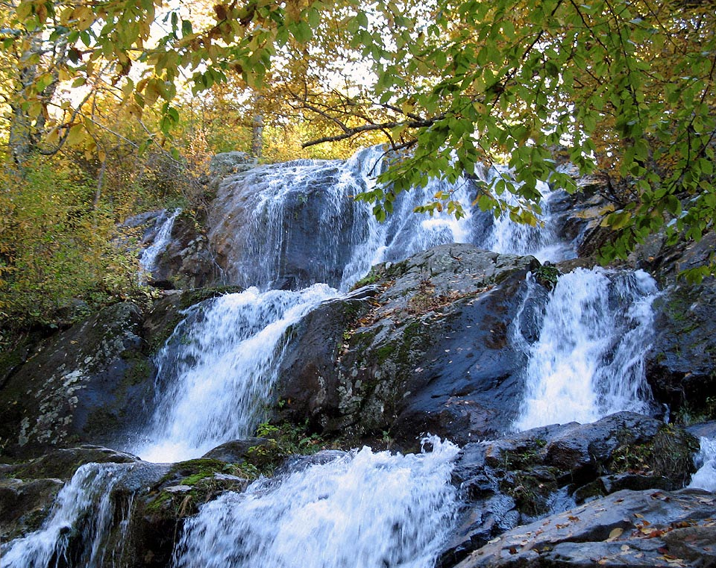
Dark Hollow Falls
Notes:
Like the resistant layers in Great Smokey’s Ocoee Supergroup, waterfalls often occur where streams struggle to down cut through the durable Catoctin Formation.

Slide 37
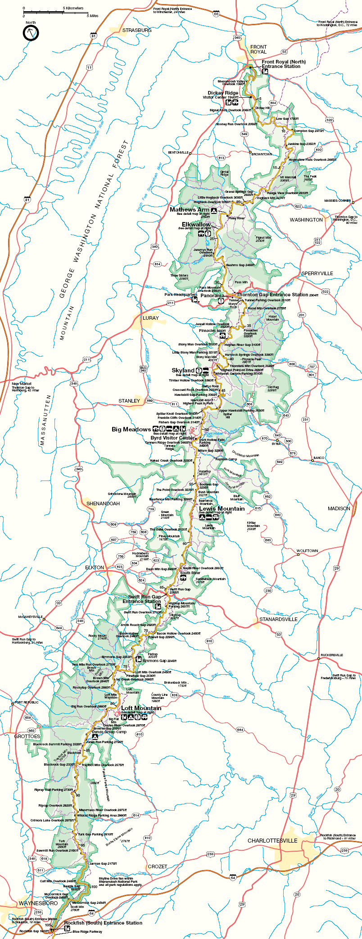
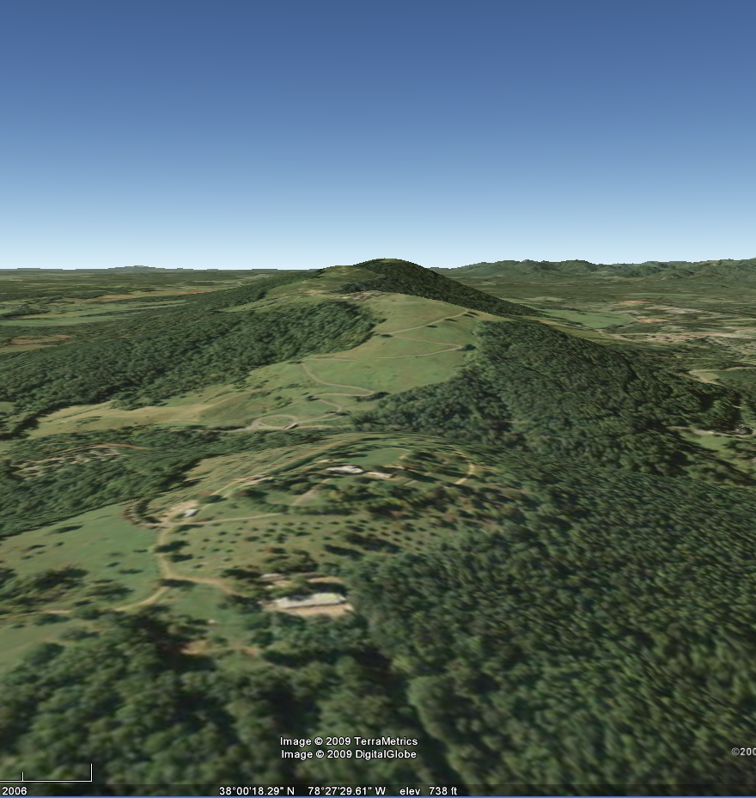
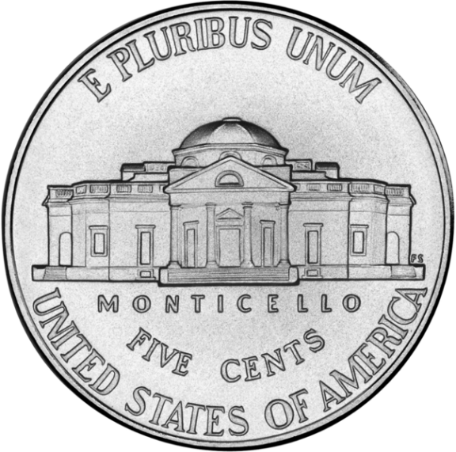
Notes:
The durability of the Catoctin Formation formed the hill atop which Jefferson’s home Monticello is built near the southern end of Shenandoah National Park.

Slide 38
Catoctin Fm. is relatively resistant
Notes:
Where the durable Catoctin Formation layers are exposed in the nearly horizontal limb of Shenandoah’s overturned anticline ….

Slide 39
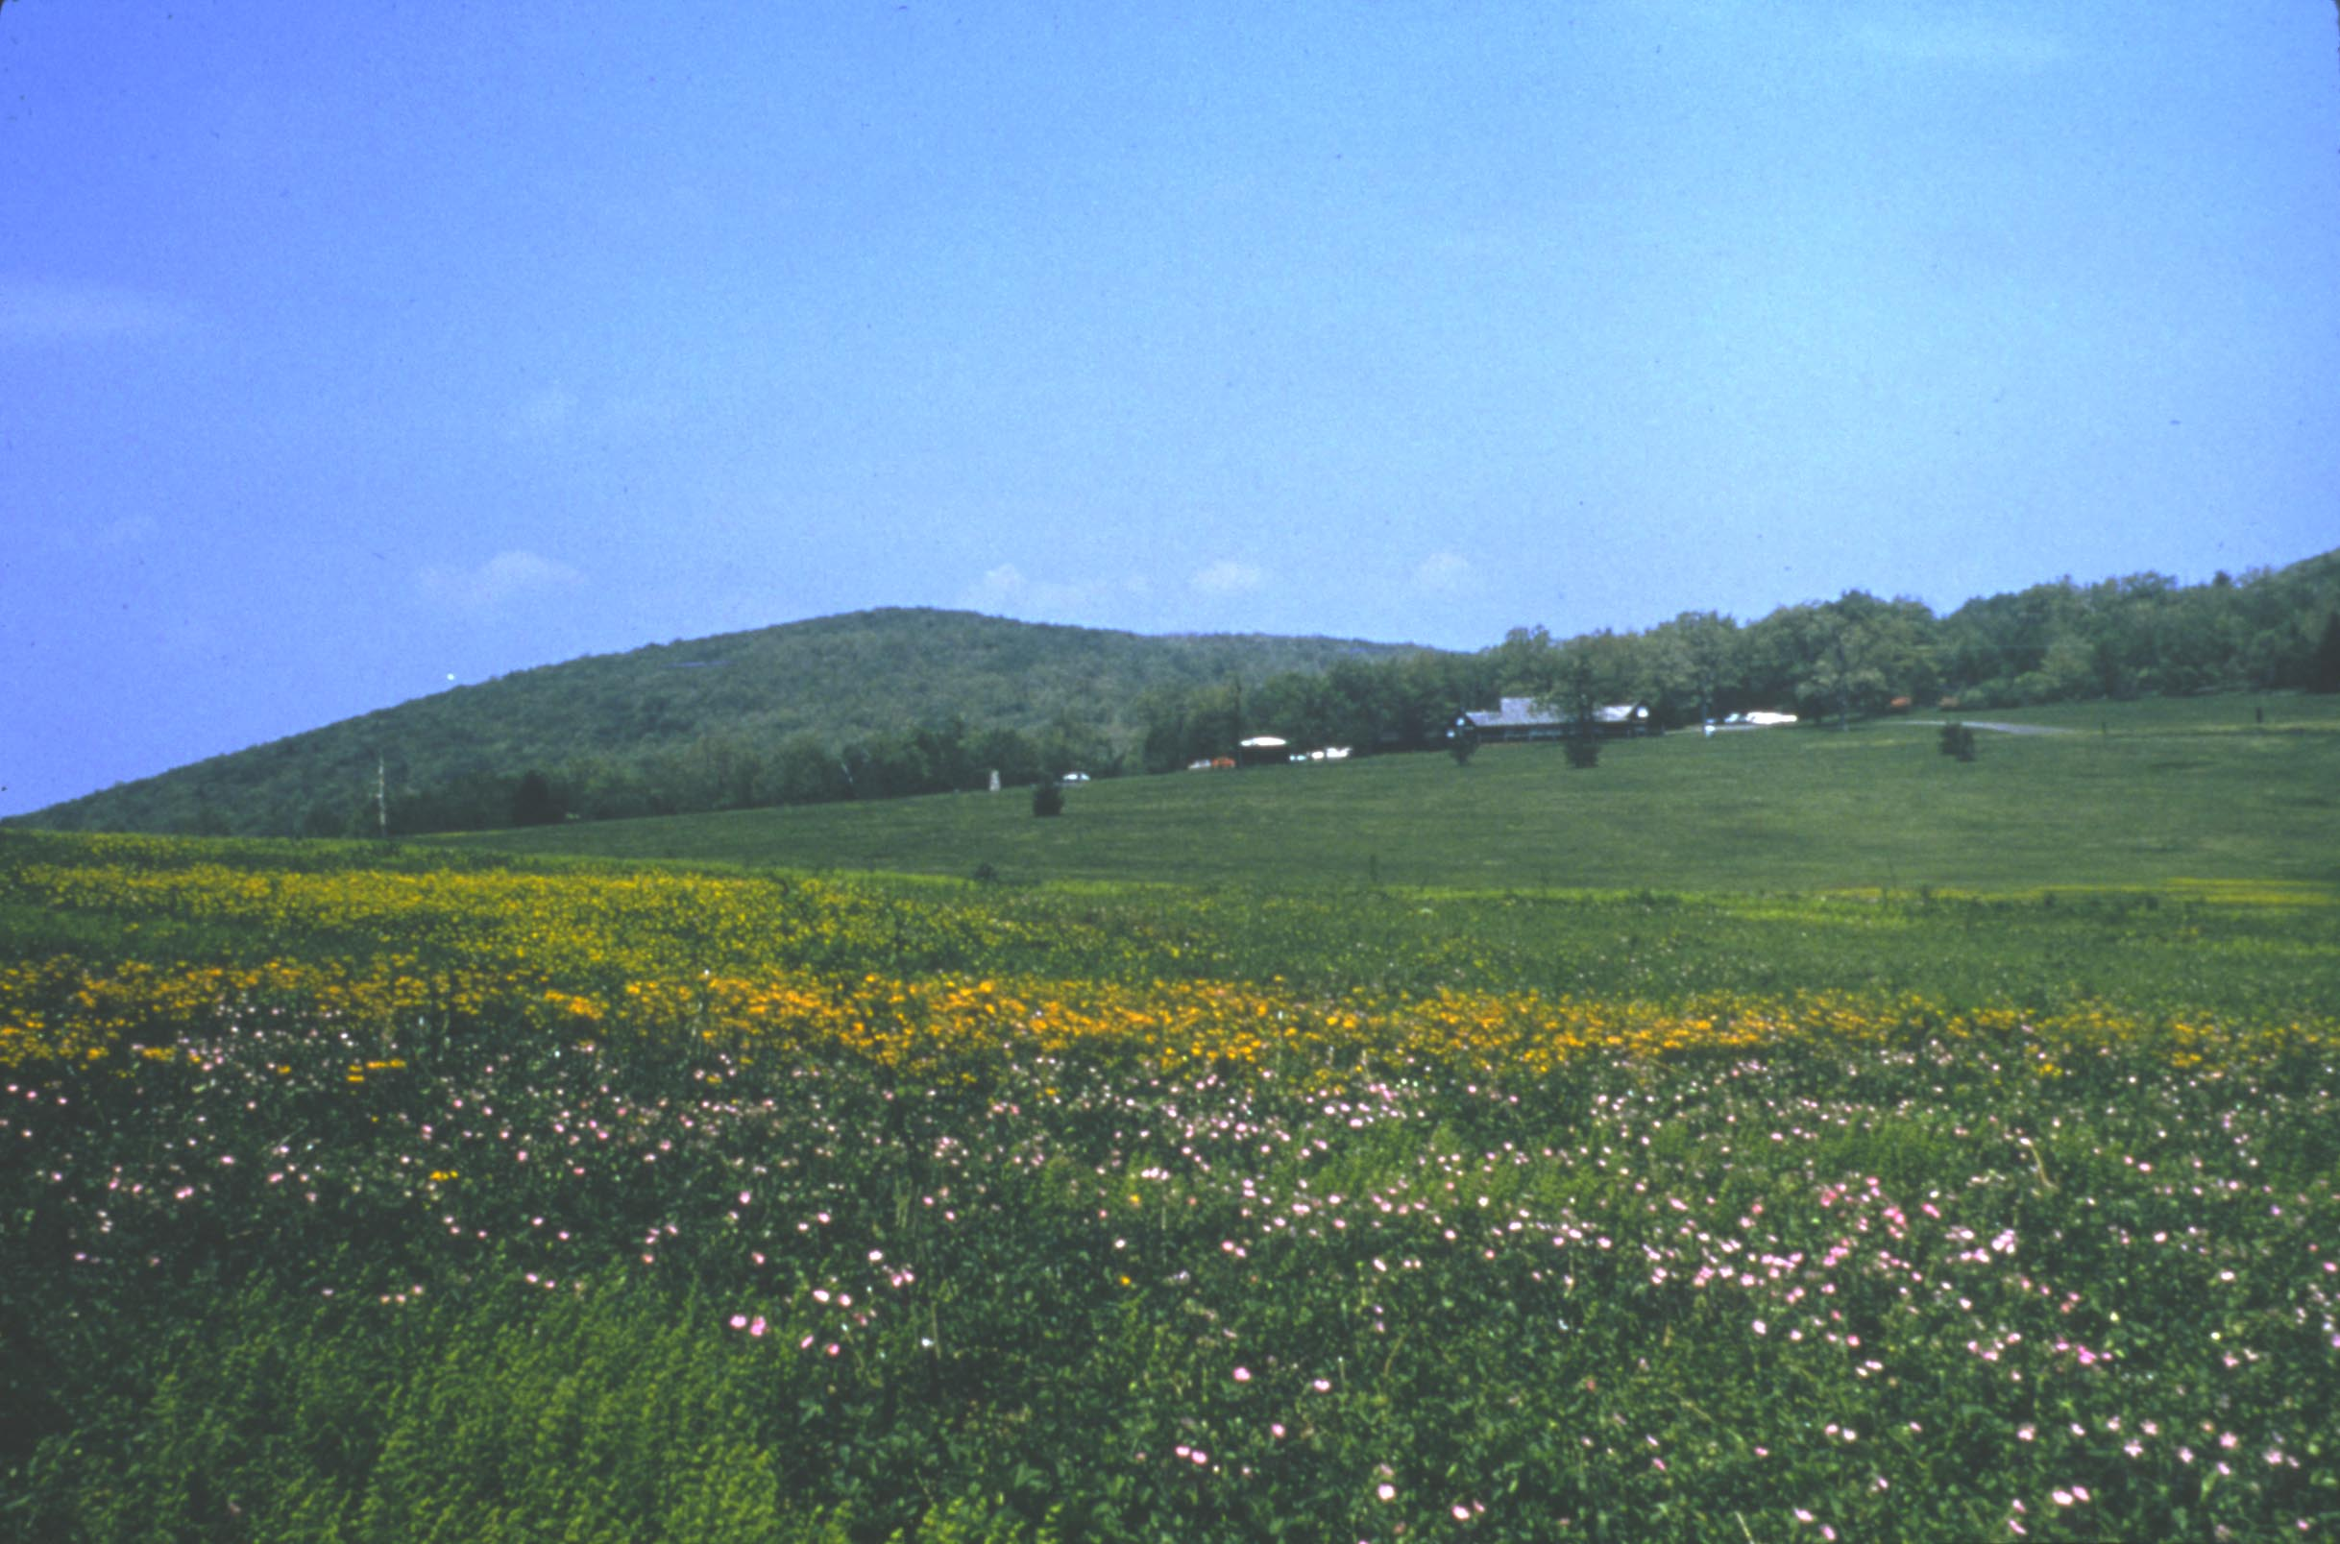
Big Meadow – 12+ Catoctin lava flows (1800’ thick)
Notes:
… broad flat areas like Big Meadow have formed. Here the Catoctin lava is some 1800’ thick. All that lava had to have some way of getting from the mantle to the surface.

Slide 40
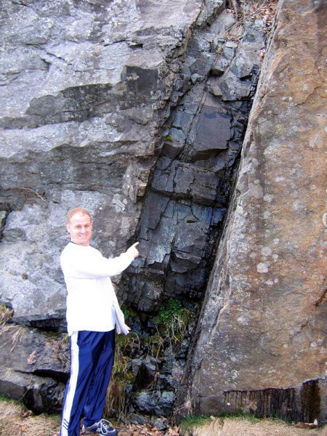
Basalt feeder dike at Little Devil Stairs
Notes:
That was accomplished via a network of remarkably well-preserved basalt feeder dikes which fairly common in Shenandoah National Park.

Slide 41
Do I really need to point to this?
Notes:
…

Slide 42
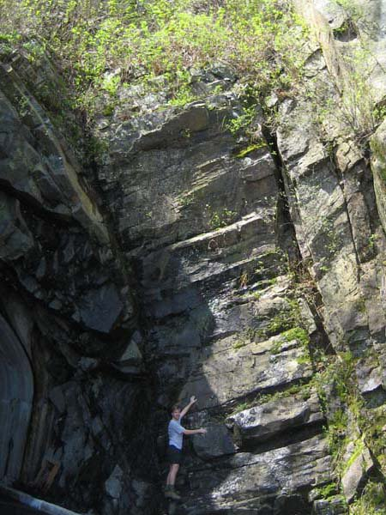
Catoctin feeder dike cutting through Pedlar Formation
Notes:
This big Catoctin feeder dike cuts through the Pedlar Formation at the north entrance to Mary's Rock tunnel and gives some perspective on the enormous amount of basaltic magma that once surged through fissures like these.

Slide 43
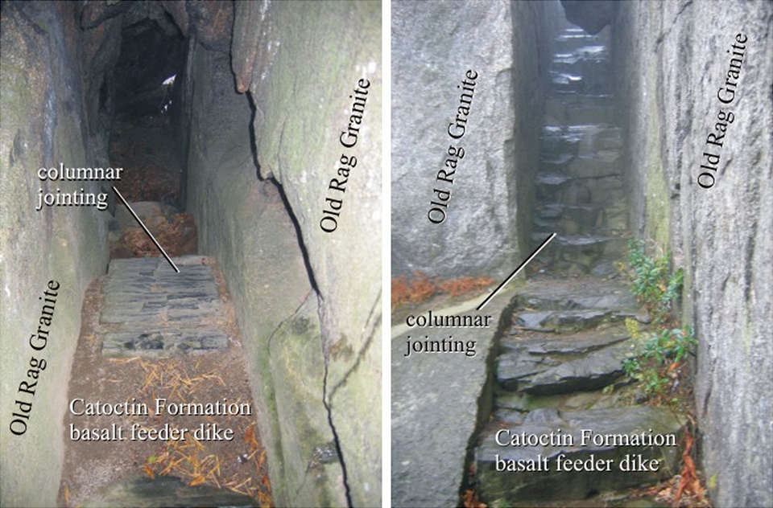
Notes:
Although the metamorphosed basalt flows are more durable than their associated meta-sedimentary rocks, the basaltic feeder dikes are less durable than the crystalline basement rocks they typically intrude. This is intriguingly evident on Old Rag Mountain's "Summit Trail” which follows an long, deep, corridor-like slot along an eroded feeder dike.

Slide 44
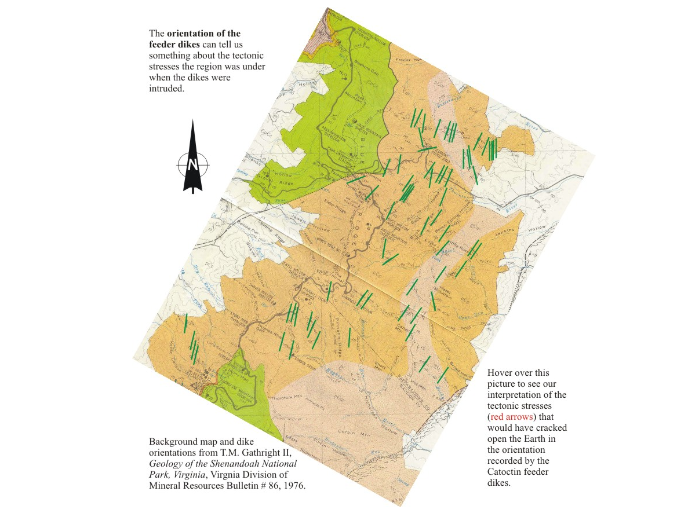
Notes:
The NNE to SSW orientation of the feeder dikes tells us that …

Slide 45
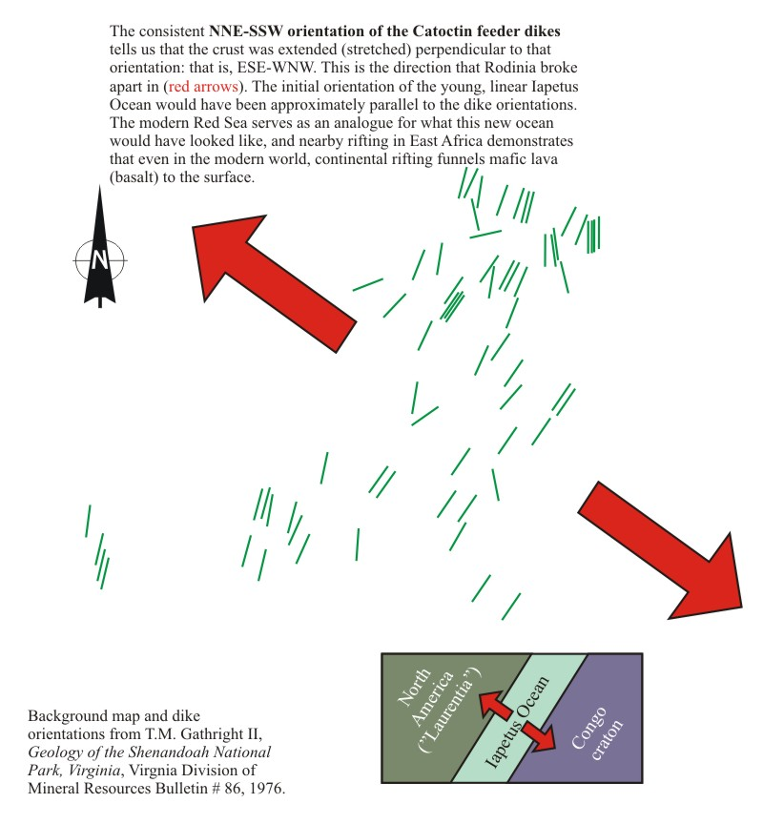
Notes:
… they were made by WNW to ESE tension as Rodinia/Pannotia broke apart and the Iapetus Ocean formed.

Slide 46
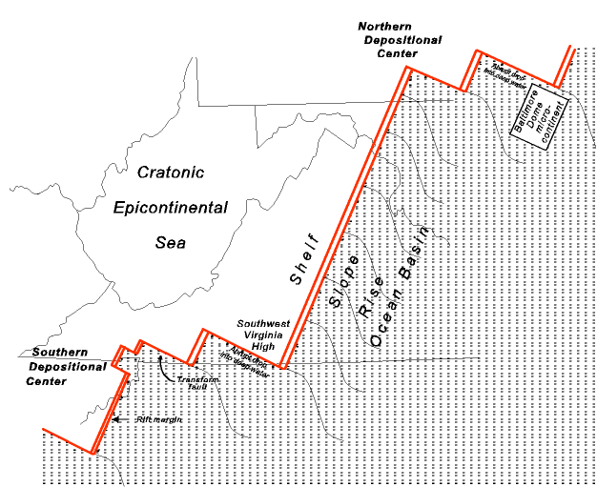
Notes:
Careful mapping in the Appalachians reveals the location of the late Proterozoic Rift. The double red lines are rift boundaries and the single lines are transform faults. Note how irregular the continental margin is with sharp promontories sticking out and reentrants. These will play important parts in later geologic events.

